Slide 1
Parliamentary Procedure
Notes:
Begin with Parli Pro Word find. Prize to the two people who find the most words or are the first 10. I would do this no more than 5 minutes. I would end with voluteers and role playing .

Slide 2
Contest Overview
2 Parts: Objective test & Meeting Presentation.
20 Min Prep Time
9-11 Min Presentation
8 Min Warning

Slide 3
In a Deliberative Assembly:
A quorum must be present
Everyone has equal weight: expressed in one vote
Only one issue/one person speaking at a time
Rights of minority protected
Notes:
A deliberative assembly is one in where parliamentary law is used
Quorum is the smallest number of people you can expect to come to efficiently conduct business, but you don’t want too small of a number so that a minority is able to overtake the ideas/plans of the majority.
Some specific motions that can be made even when no quorum is present include a motion to recess, fix the time to which to adjourn, adjourn, and other privileged/incidental motions that don’t relate to business.
The rights of the minority are protected, and it requires a ⅔ vote to pass a motion that takes away the rights of members (limit the time for debate)

Slide 4
Agenda
Minutes
Series of special/general orders
Special: Assigned a time
When the assigned time for the special order arrives, all business is put immediately to vote or tabled
Record of what was done, not what was said
Should include
Name of organization
Date and time
If the chairman & secretary was present. Who served in their place if they werent.
Whether the minutes of previous meeting were approved
Results of votes
signature of secretary
Notes:
Agenda is usually synonymous with an order of business/program, but an order of business usually refers to the order that an organization with regularly scheduled meetings uses. Agendas and programs are usually used in conventions, because in conventions it is helpful to provide place and time of events and agendas include place and time.
Special orders are different in that they assign a time, which is helpful for members (for example) if you’re conducting an important vote so members know what time they might want to arrive for a meeting. It can also be used if you’re having a guest speaker, so the guest speaker is ensured that they’ll have adequate time to speak.
Other things that minutes should include are new motions that are introduced, people who introduce new motions, old business, announcements, etc.

Slide 5
Standard Order of Business
Call to order
Reading and Approval of Minutes
Reports of Officers & Committees
Reports of Special Committees
Special Orders
Unfinished Business
New Business
Program or Special Guest
Adjourn

Slide 6
How to Make a Motion
A member is recognized by chair to speak
The member makes a motion, “I move that . . .”
The chairman asks if there is a second to the motion if one is not given.
The chairman repeats the motion as stated and opens floor to discussion (If is a debatable motion)
Maker of the motion gets first right to debate if they choose to do so.
When everyone has had the chance to speak, chairman restates question and puts it to a vote (voice vote, show of hands, ballot, roll call)
Notes:
When the chair opens the floor to discussion, s/he usually looks to the person who made the motion because they have the right to speak first. So even if someone else stands up or raises their hand before the person who made the motion does, the floor is still given to the person who made the motion.

Slide 7
Debate
Member who makes the motion is entitled to debate first if he or she chooses.
You cannot speak a second time until everyone that chooses has spoken at least once.
If possible, chair should alternate between those for and against the motion.

Slide 8
Voting
Voice: If results are doubted you can call Division of Assembly
Rising or Show of Hands: Allows to physically count number of votes.
Ballot: Physical counting of votes and allows members to remain anonymous.
Roll Call: Calling on each member from the roster to vote another way to physically count the votes.
Unanimous Consent: Asking if there are any objections to adopting the motion. If there is one objection you must take a vote.

Slide 9
Voting
If a motion is undebatable or debate has ended, the chair states the question and puts it to a vote.
If the motion is debatable and no ones is asking for the floor, the chair should inquire, “Is there any further discussion?”, if none then they can put the motion to a vote.

Slide 10
Announcing The Vote
The chair should state first if the motion passed or failed.
State the effect or results of the vote.
If no pending business is on the agenda, the chair should ask, “is there any further business?”

Slide 11
Main Motions
Introduces a new subject for discussion and vote of action.
Notes:
In the order in which they can be made: no main motion can be made if a subsidiary or privileged motion is pending.

Slide 12
Subsidiary Motions
Apply directly to the main motion or pending secondary motion.
Help the assembly arrive at a final decision on the main motion.
Lay on the Table
Previous Question
Limit or Extend Debate
Postpone to a Certain Time
Refer to Committee
Amend
Postpone Indefinitely
Notes:
In general in terms of voting, a ⅔ vote is required for any motion that takes away the rights of members (Previous Question, Limit or Extend Limits of Debate), or for any motion that changes something that has already been done (to amend something already adopted, rescind)
A ⅔ vote can be substituted for a majority vote with previous note or a majority vote of the entire membership.

Slide 13
Privileged Motions
Deal with anything related to the comfort of the group or situations that are important enough to interrupt business.
Fix Time to Which to Adjourn
Adjourn
Recess
Question of Privilege
Call fo Orders of the Day
Notes:
Because Adjourn is ranked higher than Recess, the motion to recess can not be made if the motion to adjourn is pending.
Fix the Time to Which to Adjourn does not influence the time when the current meeting will adjourn.

Slide 14
Incidental Motions
Generally, deals with procedures and help process other motions. Helps the group conduct business.
Suspend the Rules
Withdraw
Object to the consideration of the question
Point of Order
Parliamentary Inquiry
Appeal
Division of the Assembly
Division of the Question

Slide 15
Motions that Bring a Question Before the Assembly Again
Bring back motions for a different decision.
Reconsider
Rescind
Take from the Table

Slide 16
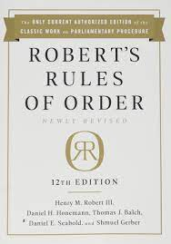
Resources
Robert's Rules of Order is the recognized guide to smooth, orderly, and fairly conducted meetings. This 12th edition is the only current manual to have been maintained and updated since 1876 under the continuing program established by General Henry M. Robert himself.

Slide 17
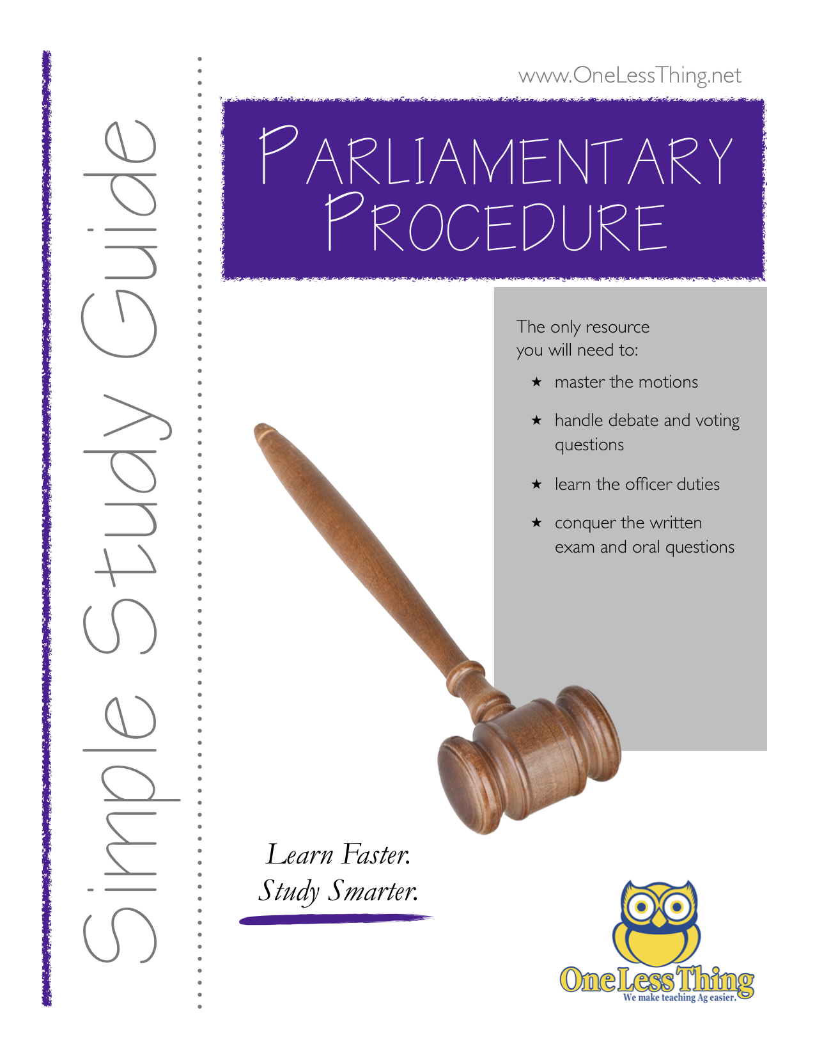
Resources
Many resources out there are very thorough but also confusing.
This reference will make learning parli pro quick and effective. Sure to be your go-to-guide for helping your students through the finer points of using parliamentary procedure.
Covers each individual required motion, order of precedence, handling motions, officer duties, debate, voting, motion relationships, and includes a basic glossary and a chart of motions.

Slide 18
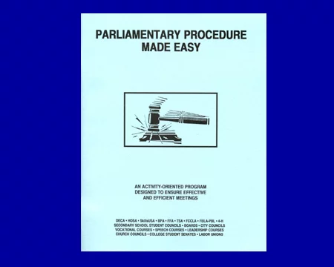
Resources
dunbarparlipro.com
Test Questions, Motion Charts, Parliamentary Procedure Made Easy, and other reseources.

Slide 19
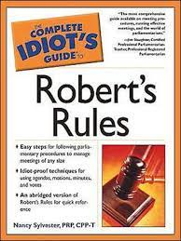
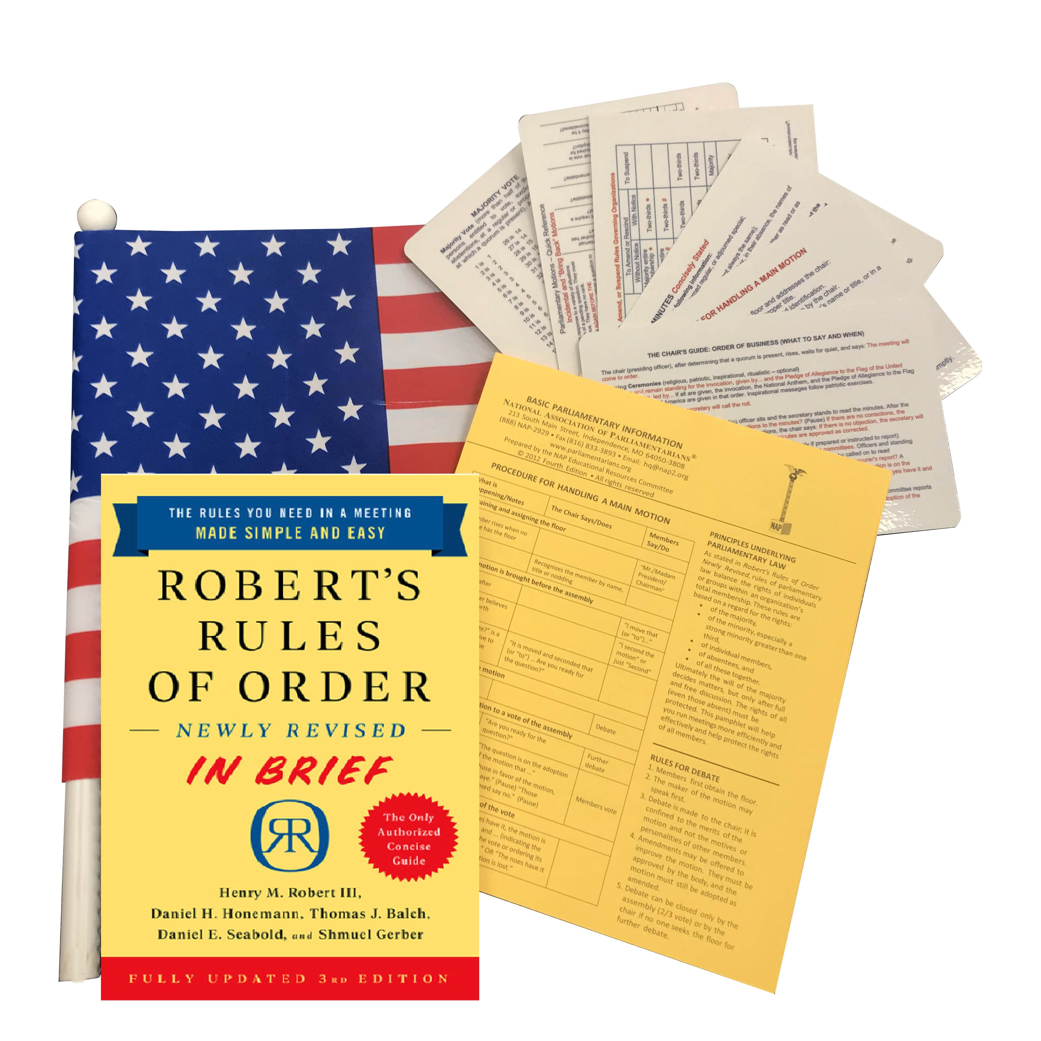
Resources
A few more resources of many.

