Slide 1
STEM/Computer Science/CTE
Michele Linch, Ph.D. – State Director
e: michele@learningblade.com
c: 501.766.3931
Learning Blade is a registered trademark of SAI Interactive, Inc.

Slide 2
STEP 1: Sign Up Today!
www.CareerBladeArkansas.com | www.ReadyforIndustry.com/AR
www.LearningBlade.com/AR
Learning Blade and Career Blade are registered trademarks of SAI Interactive, LLC.
Ready for Industry is a trademark of SAI Interactive, LLC.
Notes:
Mark

Slide 3
SAI Interactive brings strong experience in education solutions
Creators of KeyTrain® and Career Ready 101® for ACT WorkKeys®, acquired by ACT
Online basic skills enhancement curriculum
Helped to create the National Career Readiness Certificate
Used in approx. 15% of US high schools and in other agencies
Managed 28 statewide contracts with over 4 million registered users
Delivered 7.2 million lessons and 2.4 million hours used per year
Statistically proven effective at raising basic skills test scores
Tennessee-based WBE, MBE and Small Business of the Year for Chattanooga

Slide 4
Thinking Media Resources Provide Lifelong Career Awareness
Scalable solutions that build awareness, interest and preparedness for high-demand careers
K-6
Middle School
High School
Post-Secondary
Lifetime

Slide 5
Thinking Media’s Systems Provide Lifelong Career Awareness
Format | Lesson Plans | Online and Lesson Plans | Online Lessons and Activities
Grades | K-12 | 5-9 | 10-Adult
Focus | Introduce high-demand careers: Optional- connections to local employers | Introduce STEM and CS careers through Mission-based activities | Provide incoming workers with the knowledge to select and be successful in high-demand industries
Learning Blade and Career Blade are registered trademarks of SAI Interactive, Inc.
Ready for Industry is a trademark of SAI Interactive, Inc.
Notes:
Mark

Slide 6
Sign Up Today!
www.CareerBladeArkansas.com | www.ReadyforIndustry.com/AR
www.LearningBlade.com/AR
Learning Blade and Career Blade are registered trademarks of SAI Interactive, LLC.
Ready for Industry is a trademark of SAI Interactive, LLC.
Notes:
Mark

Slide 7
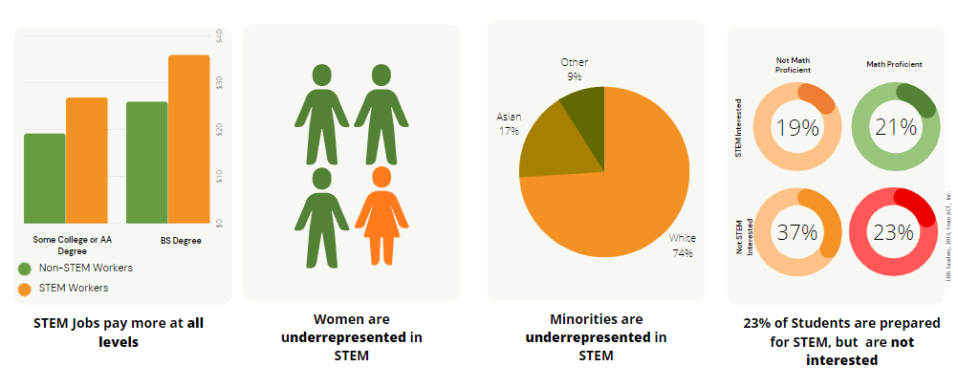
Demand for STEM, computer science, career tech workers is growing, but participation by students is lacking.

Slide 8
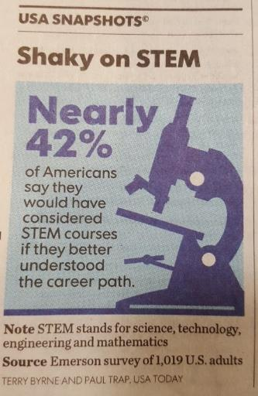
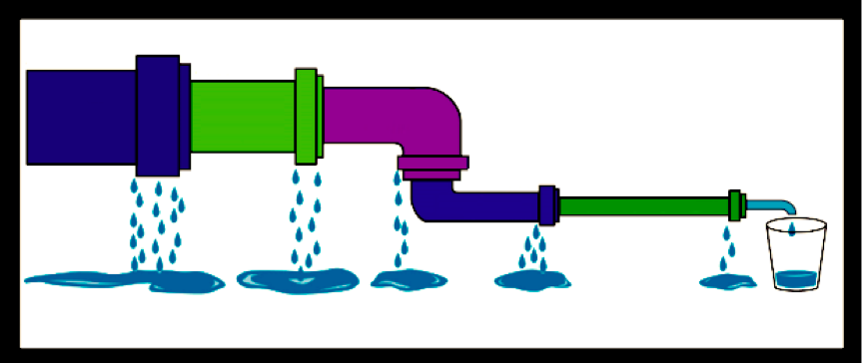
Students need exposure to STEM careers as early as middle school.
Reason Students do not Major in STEM is Lack of Awareness of Careers
Middle School Students Making Career-Related Decisions
No. 1
94%
"Increasing Student Interest in Science, Technology, Engineering, and Math (STEM)" UMass Donahue Institute Research and Evaluation Group, 2011, as retrieved from http:www.mass.edu/forinstitutions/prek16/documents/Student%20Interest%20Summary%20Report.pdf

Slide 9
We introduce students to CS and STEM Careers through “Missions”.

Slide 10
Each Mission includes an interactive toolbox of lessons and activities.
Interactive online lessons, ready-to-use lesson plans and activities for middle and high school students. Can be used by any teacher, anywhere. Validated and proven to increase STEM/CS/CTE career interest.
Interactive Lessons
Hands-On Projects
Design Thinking
Parent Discussions
Over 400 online lessons tied to academic standards
Mission challenges are project-based lessons using common materials
Solve complex problems with the 5-step creative thinking process
Handouts and easy experiments for at-home discussions
Career Videos
3D Printing Activities
Intro to Coding
Papercraft Figures
Introduce over 50 careers with real-life people
Create objects that demonstrate science principles
20 hour middle school course providing robust coding experiences
Students make origami-type figures of 100 careers and technologies

Slide 11
“Missions” involve a societal challenge that interests students.
Mission Challenge Career Clusters
Dolphin Rescue | Help rescue rehabilitate an injured dolphin, including creating an artificial prosthetic tail | Biomedicine, Marine Science
Haiti Orphanage | Design and build an environmentally-sound orphanage for children left homeless by an earthquake in Haiti | Construction, Sustainability
Heart Surgery | Conduct heart surgery and therapy for a child with a heart defect; evaluate the use of artificial hearts or heart components | Medicine
Energy Production | Evaluate alternative or upgraded energy sources for a city that currently has an old coal-fired power plant | Energy Production, Environment
Local Food | Consider methods to increase production of local foods in a community | Agriculture
Robotics Design | Explore technology used for robotics design, such as sensors, electrical circuits, industrial design and computers | Electronics, Computer Science
Flu Outbreak | How health and IT professionals can use data warehousing and analysis to predict flu outbreaks using GIS and social media data | Information Technology
Transportation Jam | Evaluate new transportation methods for a city that has a traffic congestion problem | Transportation
Manufacturing Concept | Use modern manufacturing techniques to design and build a new concept car | Advanced Manufacturing
Entrepreneurship | Set up a new business with a focus on entrepreneurship | Finance, Business
Lightweight Aircraft | Design a lightweight and easily maintained aircraft for distant missions | Lightweight Metals Manufacturing
Hack Attack | Learn about methods to create and protect website, apps and social media after a school’s website and media are hacked | Computer Science
12
“Missions” that engage all students

Slide 12
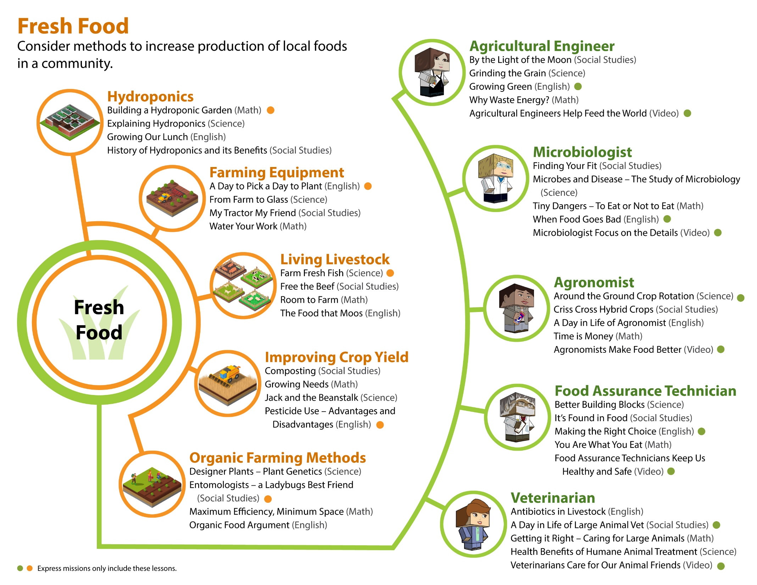

Slide 13
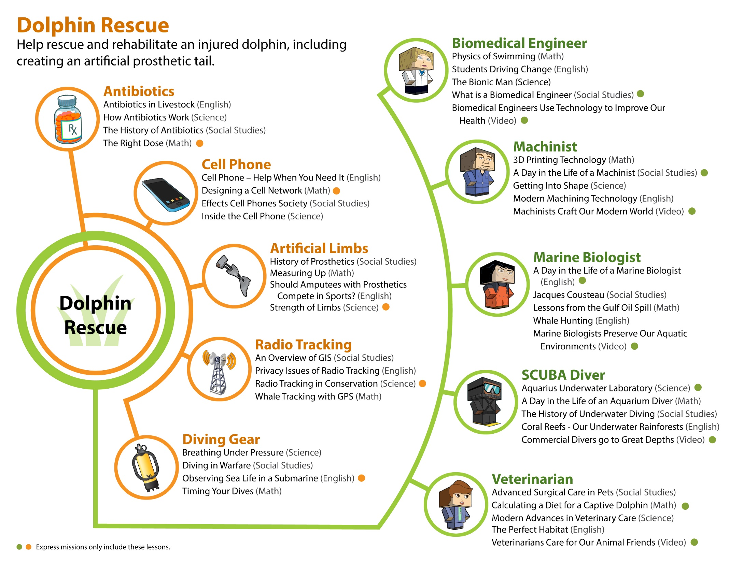

Slide 14
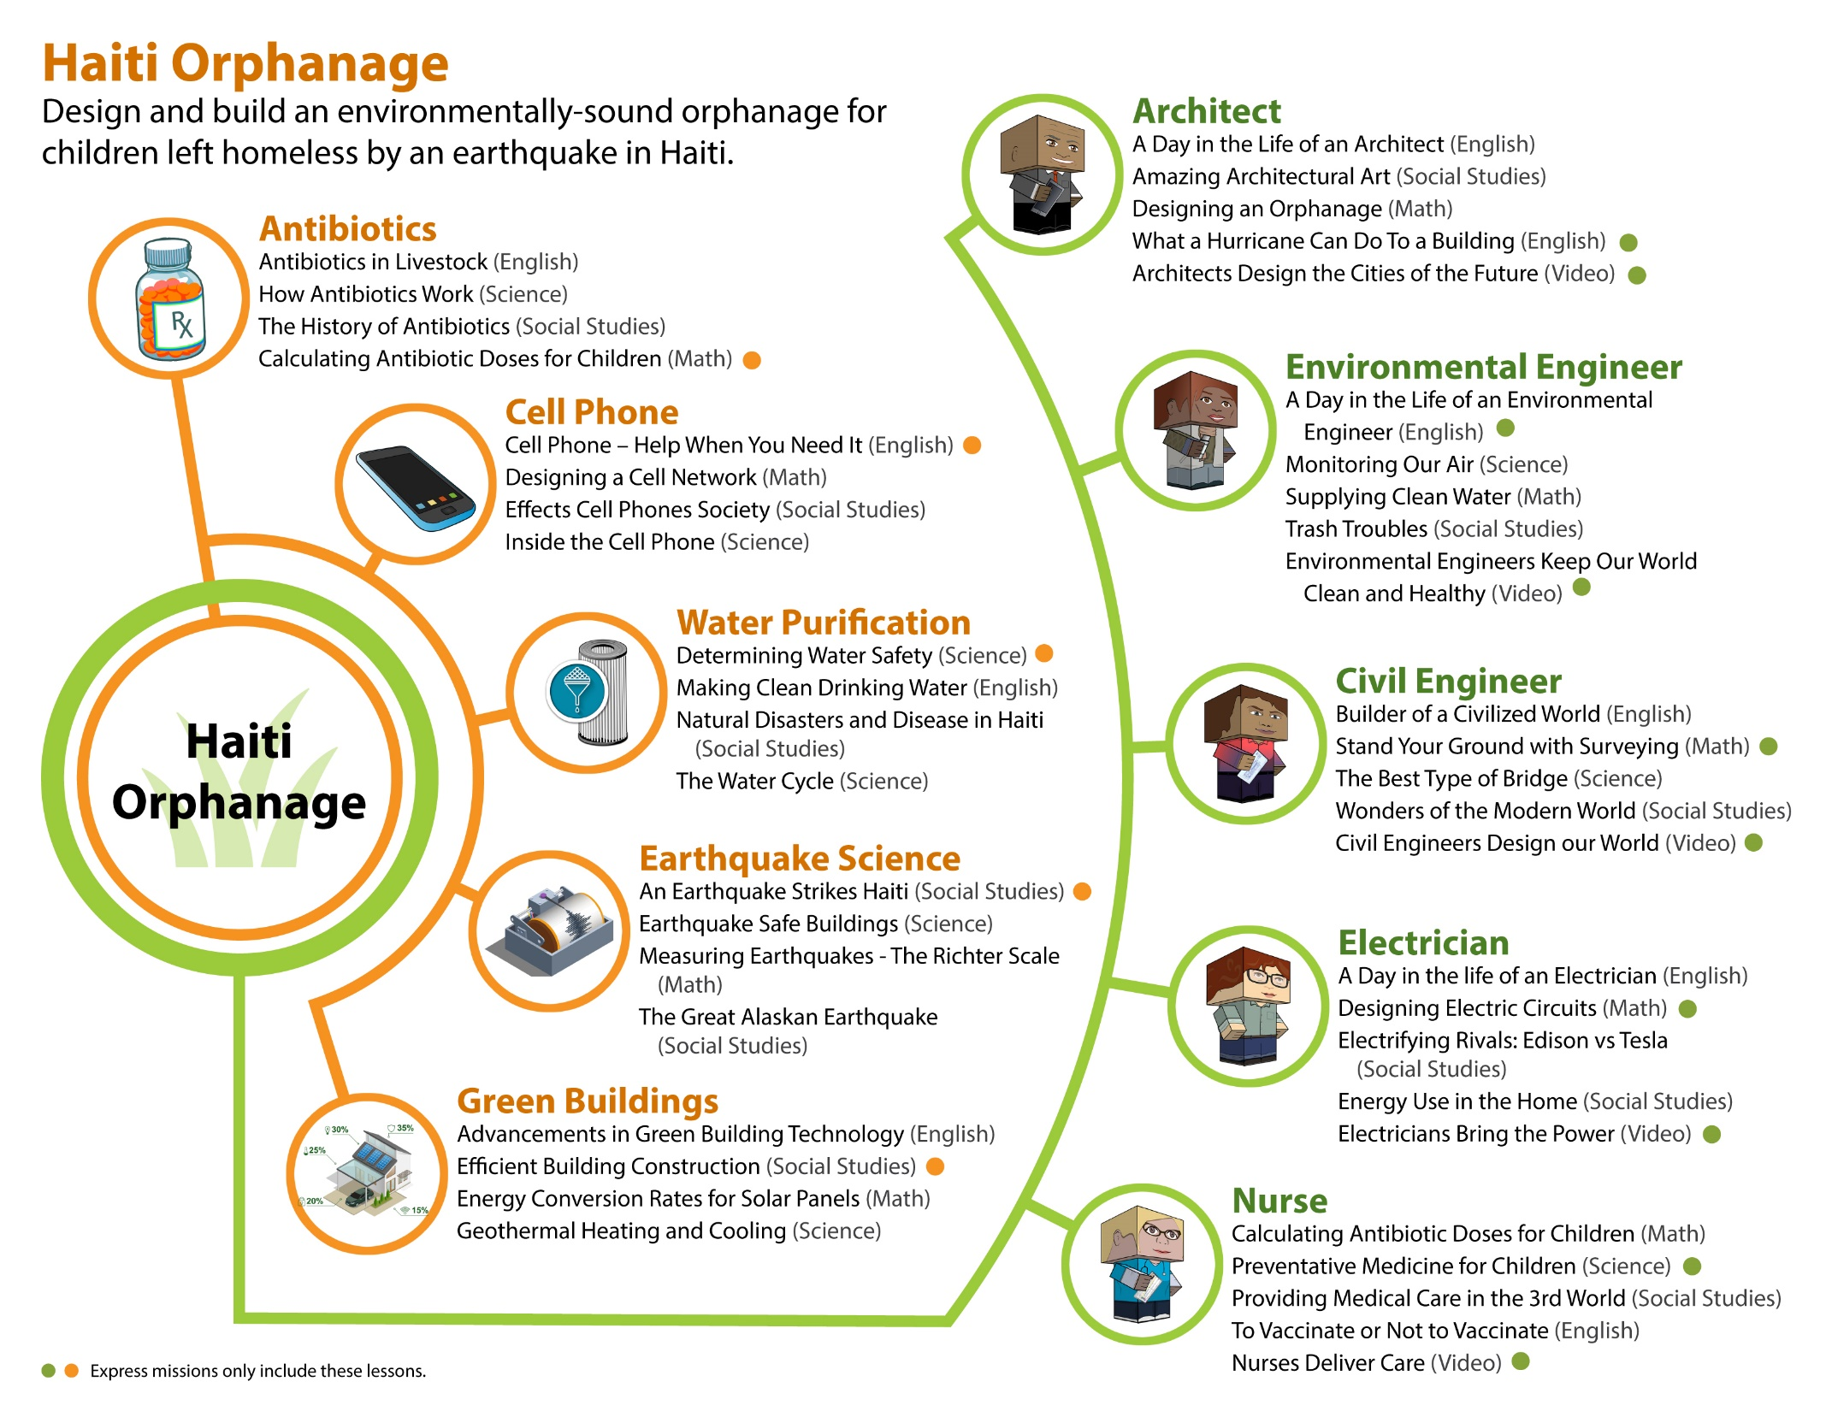

Slide 15
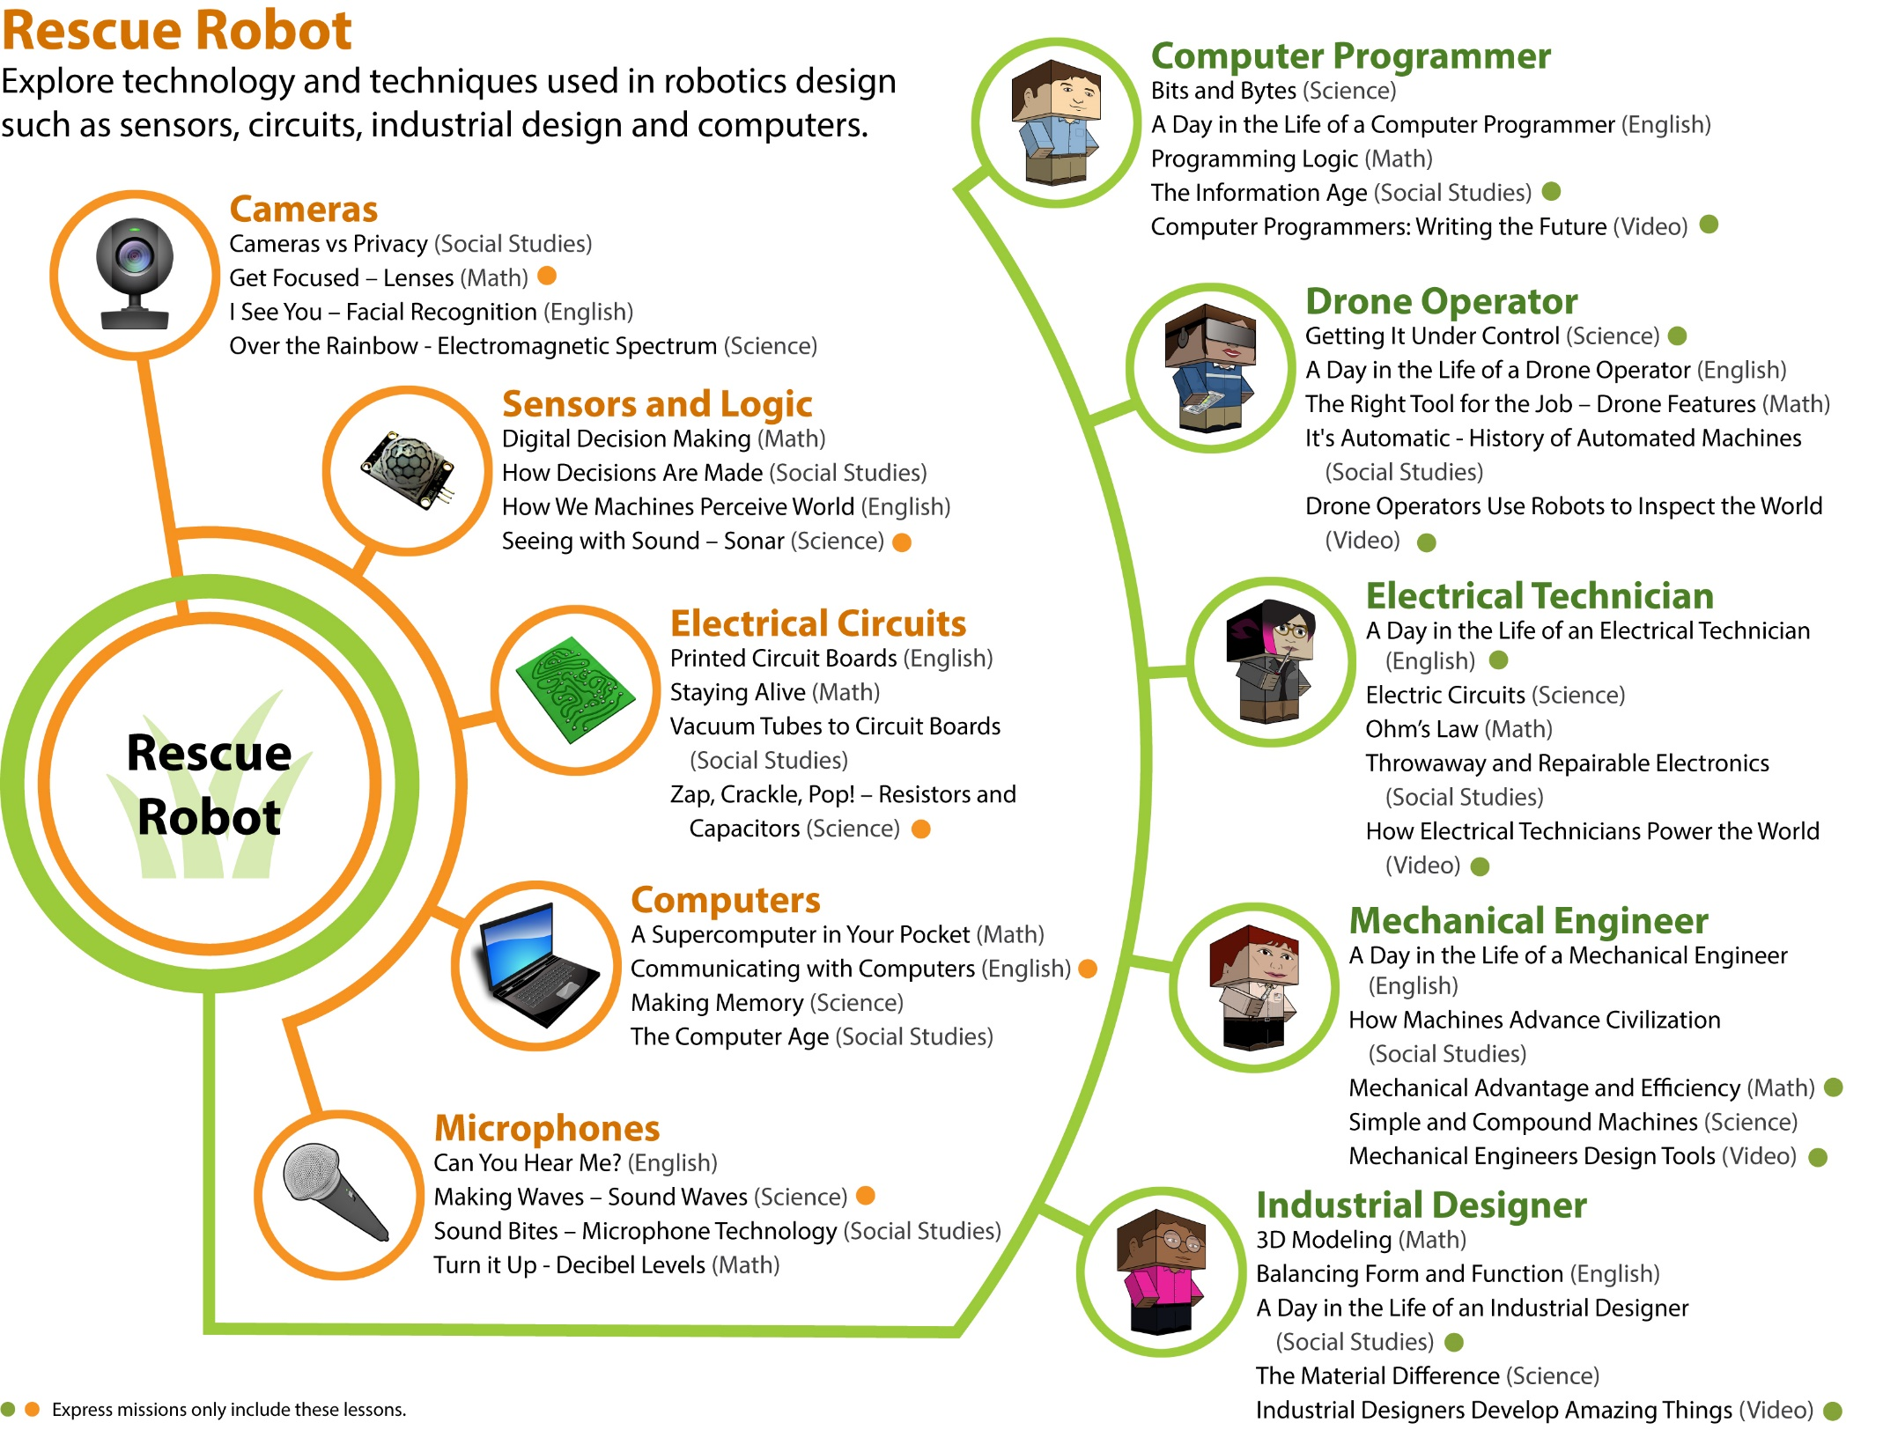

Slide 16
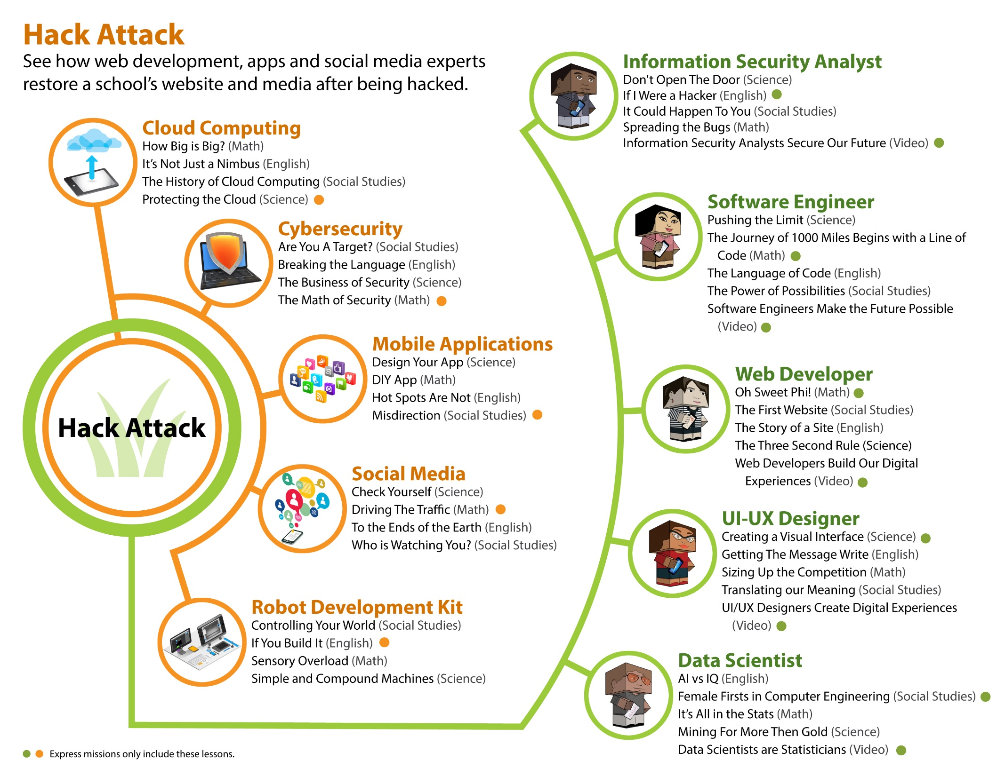

Slide 17
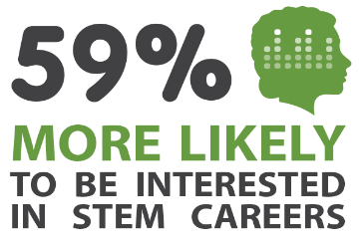
Our results have been independently validated.
Student Survey Results Validated by Battelle:
55% Increase in students who strongly agree that they are interested in a career in Computer Sci.
Doubling the # of students interested in becoming an engineer and/or scientist
79% Increase in students recognizing “Math is helpful when solving interesting problems.”
69% Increase in students recognizing “What I learn in school will be useful later in life.”
56% Increase in students interested in taking advanced math classes in high school.
Independent Ed.D. Research Results: Katherine Kendall, 2017. All items p<.001, N=276
Learning Blade users were more likely to intend to pursue STEM careers:
59% more likely to be interested in a STEM career
84% more likely to want a job that designs or builds things
140% more likely to respond that they knew what STEM workers do
70% more likely to be willing to like to talk about science with others
Selected as “Accomplished” in STEMworks database by WestEd by meeting rigorous design principles and evaluation by independent reviewers
Learn more at http://link.learningblade.com/results
Results from Student Surveys

Slide 18
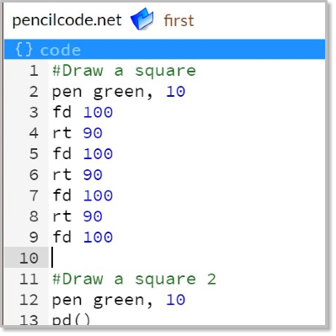
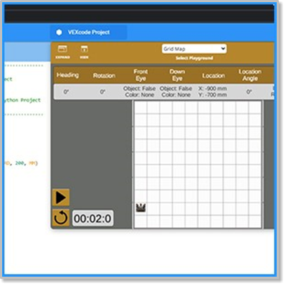
This 20-hour course provides everything you need to introduce students to computer science and real, text-based computer programming for MIDDLE SCHOOL! Includes online lessons, group classroom activities, and complete lesson plans for guiding students through authentic coding experiences. Topics include:
Learning Blade’s Introduction to Coding Course Meets the Middle School Coding Block Requirement
Computer hardware and software
Simple algorithms and common statements
Offline algorithm games
Beginning programming
Creating a simulated mobile app
Concepts of cybersecurity and personal security
Exploring common IT careers
”Having the Learning Blade tool in schools, students are exposed to the world of CS courses, CS opportunities, and CS career paths, and that is getting more students interested in CS jobs such as coding. The new "Intro to Coding" Block will continue to enhance what teachers can provide to their students." Governor Asa Hutchinson
Notes:
Arkansas Requested an Intro to Coding course

Slide 19
Course outline includes a complete context for computer science
Technologies
Computers in Our Society - The history, variety, and major components of common computers.
Basic Concepts of Programming - The purpose of programs, and the concept of simple algorithms and basic statements.
Creating Your First Code for Robots - Understanding the need for a program to control a robot, and writing a simple program to guide a virtual robot through a maze.
Mobile Applications and Cloud Computing - Planning the function of a mobile app, and creating a simple graphic virtual app.
Creating Interactive Programs - Introduction to basic programming statements, then writing programs to guide virtual turtles and create an interactive game
Common Business Applications - Introduction of common business applications such as databases, and hands-on activities using data and data tables.
Introduction to Cybersecurity - Concepts of privacy and security on the Internet, and methods for preventing hacking and protecting websites.
19

Slide 20
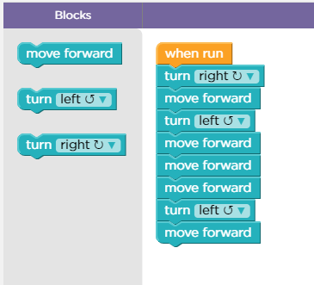
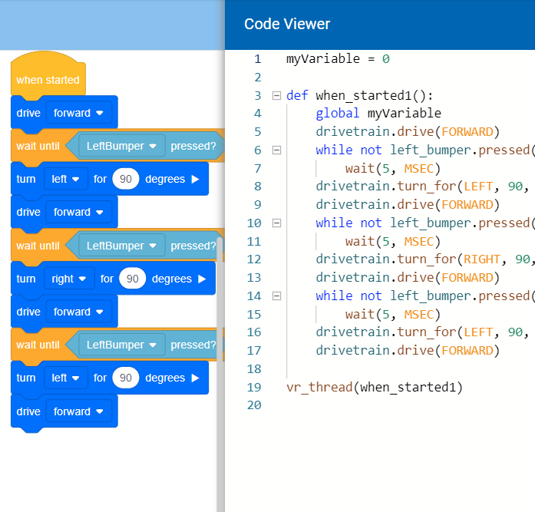
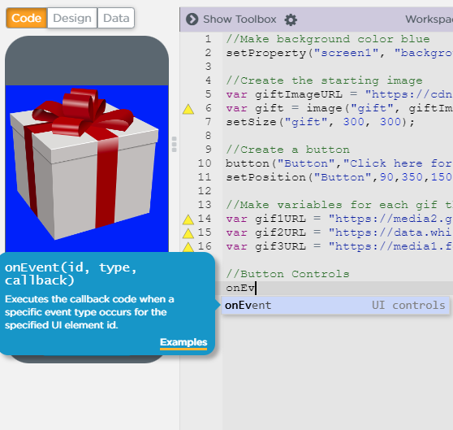
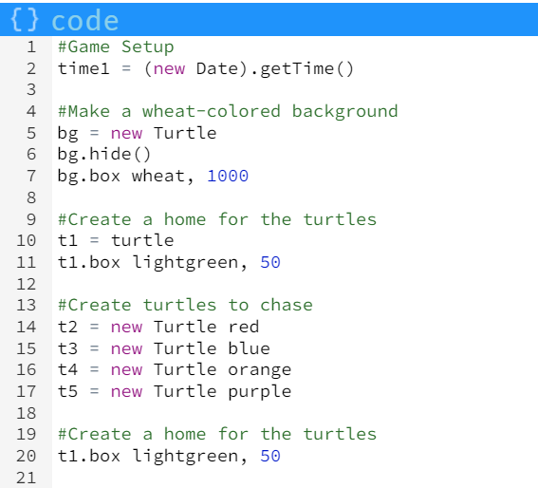
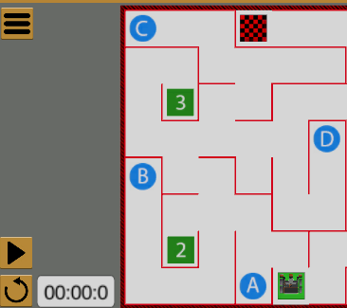
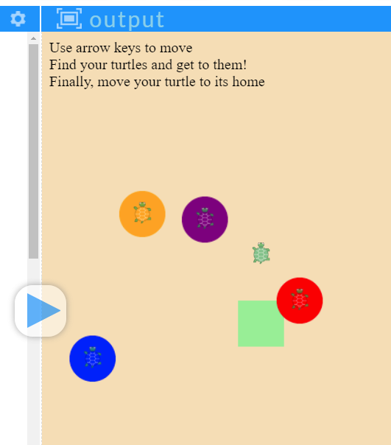
Coding Progression
Block-based coding
with text-based code viewer
Text-based coding
with suggestions and assistance
Block-based coding
Text-based coding
20

Slide 21
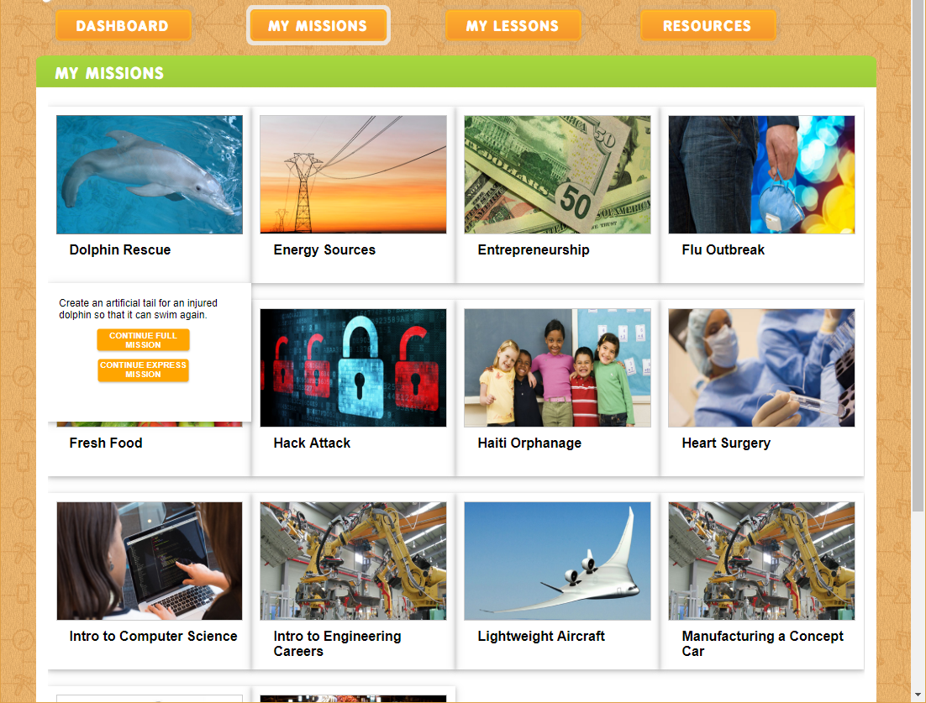
Students Can select a Mission, or teachers can assign specific Missions.

Slide 22
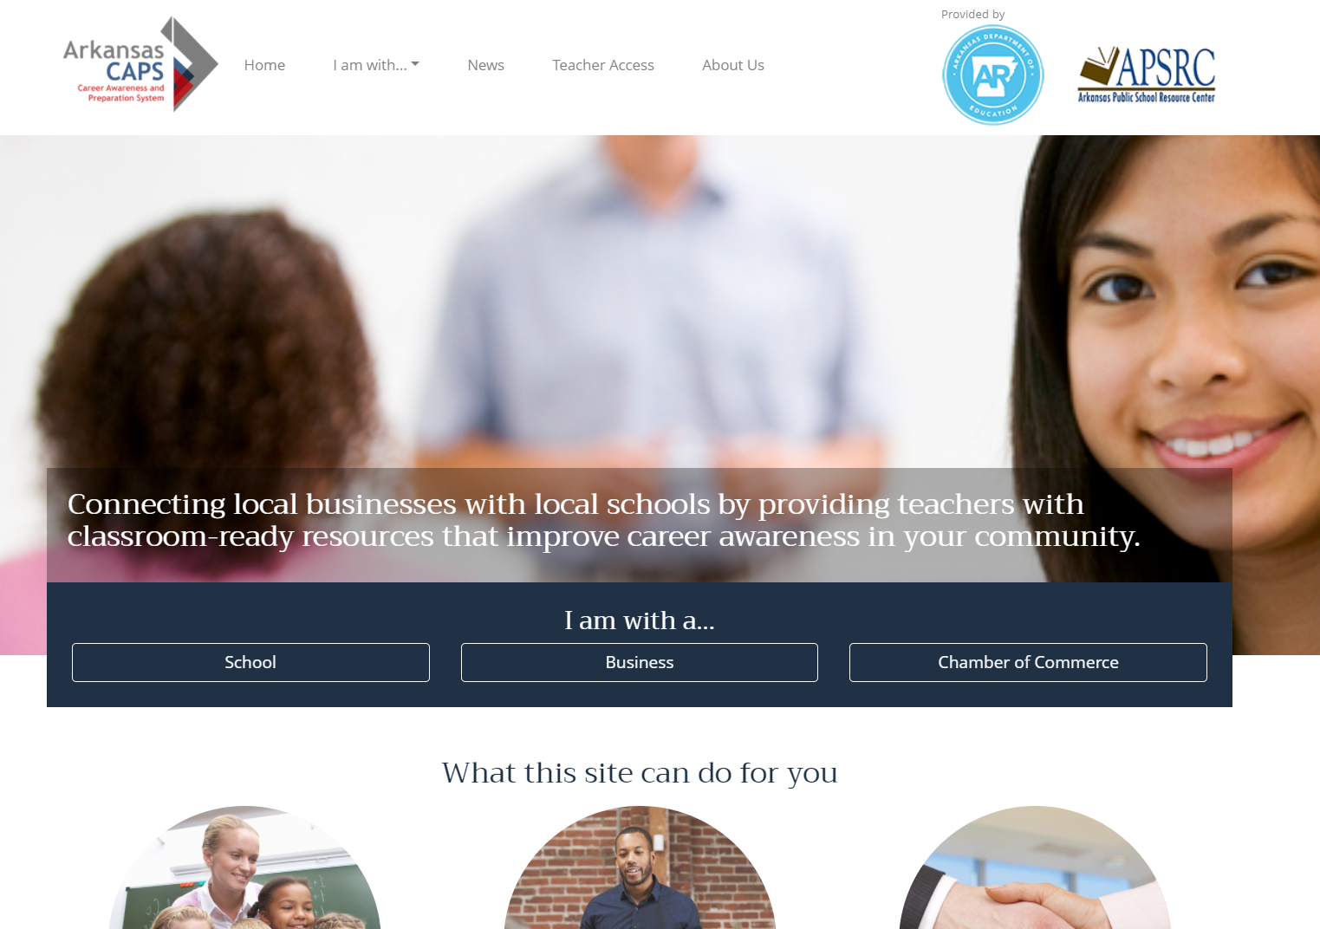
Career Blade for Arkansas www.CareerBladeArkansas.com

Slide 23
Career Blade Launched February 2022!
Explore Career Blade at www.CareerBladeArkansas.com
Career Blade is:
A FREE resource for Arkansas educators to build students’ awareness and interest of the variety of careers in your community and the businesses that hire these careers,
A set of classroom-ready lesson plans for K-12 that introduce these careers while reinforcing academic skills aligned to learning standards.
A list of contacts at local businesses who are willing to interact with your school and students.
Notes:
By Careers:
CNC Operator/Machinist
Computer Programmer
Database Administrator
Data Scientist
Electrician
Farmer / Rancher
Financial Analyst
Industrial Maintenance
Info Security Analyst
Marketing Manager
Nursing
Production Manager
Supply Chain Analyst
Truck Driver
Welder
https://www.businessroundtable.org/policy-perspectives/building-americas-tomorrow-ready-workforce/closing-the-skills-gap
https://s3.amazonaws.com/nashvillechamber.com/Talent/2015-workforce-study-executive-summary.pdf

Slide 24
We Seek to Connect Students to Opportunities in their Own Communities
Teachers across all K-12 grades lack the time and experience to help students understand today’s careers.
Teachers are highly attracted to student-ready lesson plans that support academic classrooms through group activities.
If we could embed information on careers and local businesses in these classroom activities, we could form a positive image of local businesses in the minds of the future workforce.

Slide 25
Lessons Link Academics to Local Careers
Lesson plans are individually tailored to the grade level and local regions of the state.
Lessons include:
Career Name and Description
Student Self-Paced Academic Lesson
Lesson Plan for Hands-On or Creative Thinking Problem Solving
Career Connection – how the lesson connects to the career
Salary and Outlook
Academic Standards Alignment
Local Connections – regional employers that hire this type of career

Slide 26
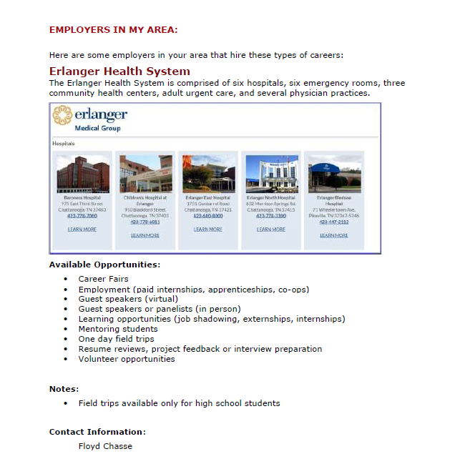
Making the Connection Between Students and Businesses
Lesson plans include specific contact and interaction opportunities:
Guest speakers or Panelists (in person, at school)
Guest speakers (virtually, via Skype / Zoom / etc.)
One-day Field Trips
Mentoring students
Video or picture uploads
Resume reviews, project feedback or interview preparation
Volunteer opportunities
Learning opportunities (i.e. unpaid job shadowing, externships, internships, etc.)
Employment (i.e. paid internships, apprenticeships, co-ops, etc.)
Career Fairs
Curriculum support or experiential learning programs
Sponsorships and/or equipment donations
Product Donation

Slide 27
Career Blade – Informs Students of Local Careers
By Grade Range:
K-2
3-5
6-8
9-12
By Local Career Blade Businesses
By Industries
By Careers:
CNC Operator/Machinist
Computer Programmer
Database Administrator
Data Scientist
Electrician
Farmer / Rancher
Financial Analyst
Industrial Maintenance
Info Security Analyst
Marketing Manager
Nursing
Production Manager
Supply Chain Analyst
Truck Driver
Welder
By Economic Region:
Central AR
East AR
Northwest AR
Southeast AR
Southwest AR
West Central AR
Western AR
White River AR

Slide 28
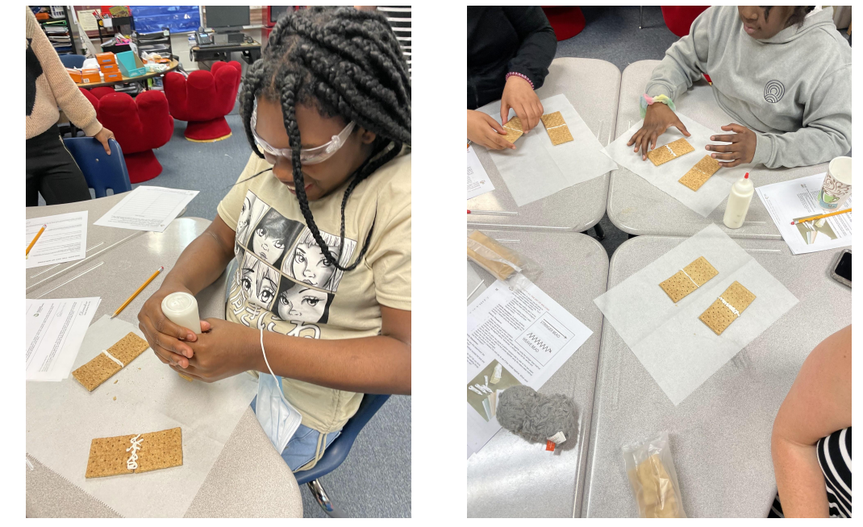
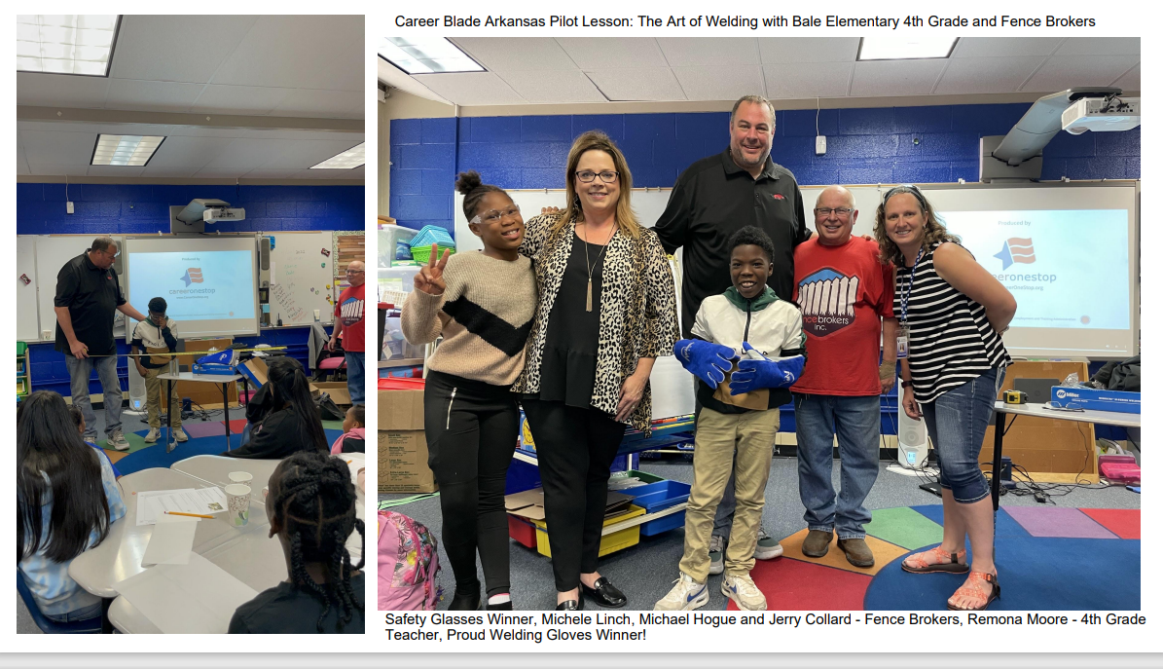
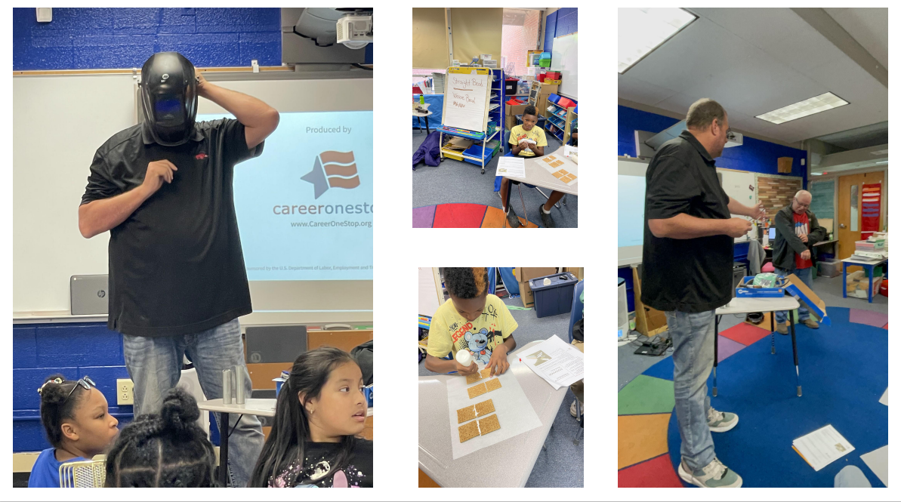
Career Blade in Action!
Fourth graders practicing their straight bead and weave bead welding techniques.

Slide 29
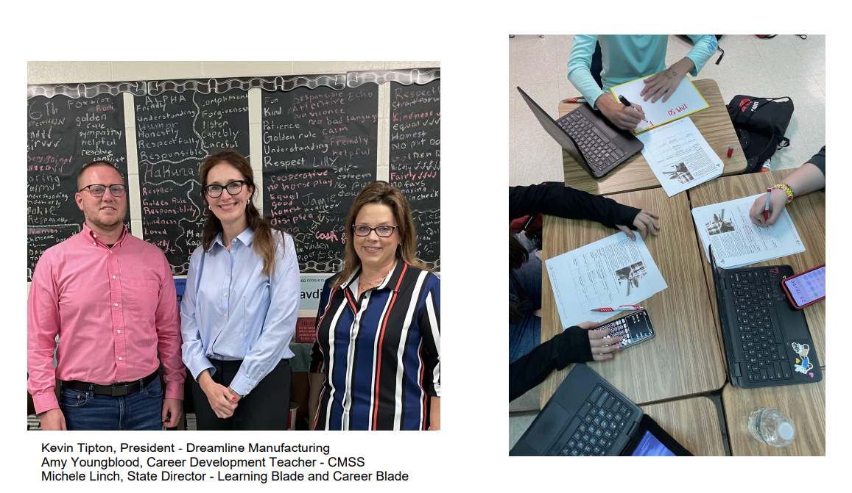
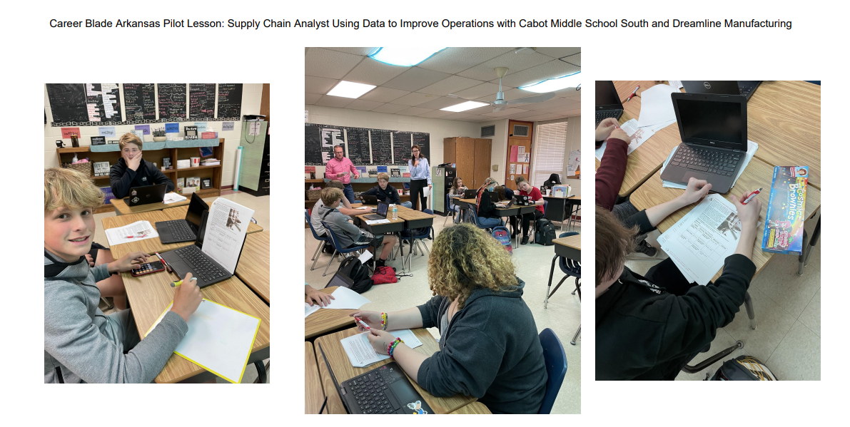
Career Blade in Action!

Slide 30
The Benefits
AR Chamber of Industry and Commerce and Local Chambers – Increases the value of the Chambers to business members by assisting businesses in increasing their visibility in their community and future labor market.
Local Businesses – Increases number of educators and students who are aware and have an appreciation of local business workforce needs. Increases the interest of students in becoming trained for the workforce needs of local business and industry.
Students – Connects students to high-demand, high-paying careers available in their own communities and encourages students to follow career pathways that will prepare them for these opportunities.
Teachers – Provides easy-to-use resources that allow teachers to communicate these high-demand career pathways to students in a way that builds STEM and academic skills that will prepare students for future success.

Slide 31
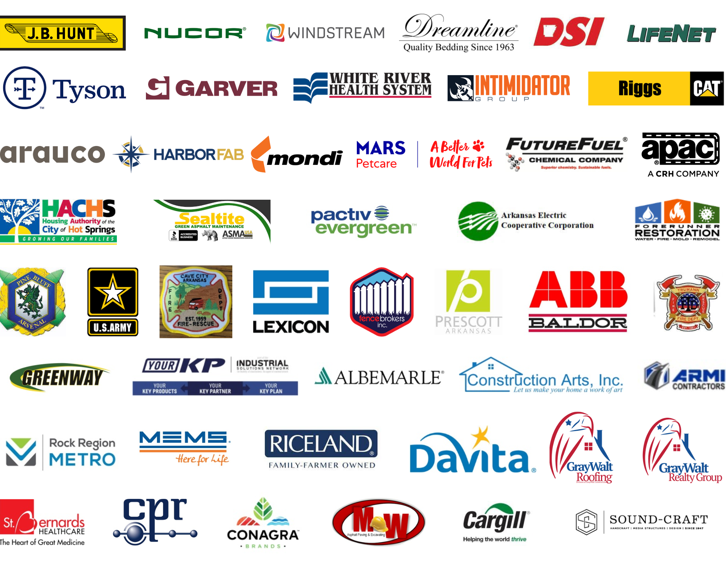
Sample Participating Companies

Slide 32
You Can Help Build Career Blade by asking Businesses to Fill Out the Survey
www.CareerBladeArkansas.com/BusinessSurvey

Slide 33
Engage in Career Blade at www.CareerBladeArkansas.com

Slide 34
Readying the Future Workforce

Slide 35
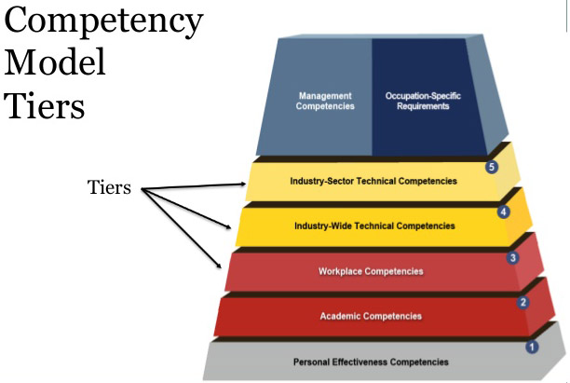
Ready for Industry™ Provides Essential General Industry Knowledge
Creates a bridge between standard K-12 education and the knowledge needed for success in industry.
Covers gaps in common technical training and the industry and workplace competencies in tiers 3 and 4 of the workplace competency model.

Slide 36
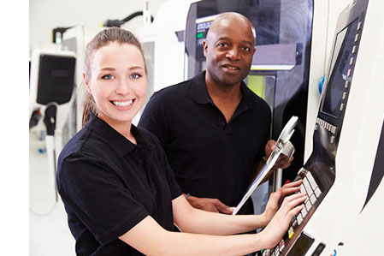
Ready for Industry Addresses Career Awareness for the Job Seeker
A new platform designed to address career awareness and preparation issues for the near-term job seeker – from late high school through adult.
RFI bridges two gaps that exist in the preparation of many potential skilled workers:
What industry pathway do I want to pursue?
What is the basic info that employers want me to know that I might not learn in school?
RFI provides separate 15-20 hour courses for each of the 5 highest-demand industries:
Healthcare
Manufacturing
Information Technology
Construction
Logistics
RFI is NOT a replacement for technical training. It provides a context for post-secondary career search and training.

Slide 37
General Course Outline
For each of the 5 highest-demand industries, RFI provides self-paced, online instruction on:
Introduction to the Industry
What it is like to Work in the Industry
Industry Terminology and Common Practices
Career Opportunities and Descriptions
Current Issues and Trends in the Industry
Career Pathways, Education and Certifications in the Industry
Workplace Expectations in Industry
Separate 15–20-hour courses for each of the 5 highest-demand industries:
Healthcare
Manufacturing
Information Technology
Construction
Logistics

Slide 38
Course Outline- Information Technology
Introduction to Information Technology
What is Information Technology?
The Importance of IT in Society
Common IT Devices and Terminology
Industrial Computing Applications
Working in the IT Industry
Typical Corporate IT Structures
Data Backup and Disaster Recovery
SaaS vs. Internal Platforms
User Accounts and Security
IT Security Policies
Identity Theft Prevention
Cyberattacks and Ransomware
Security Incident Response Plans
Basic Coding Concepts
Software Development Processes
Web Development Processes
Careers in Information Technology
Software Development
Web Development
Data Management
Cybersecurity
Hardware Design and Maintenance
Customer Service and Support
Current Issues in the IT Industry
Data Security and Privacy
Cloud Computing and IoT
Social Media
Globalization
Blockchain
Virtual and Augmented Reality
Machine Learning and Artificial Intelligence
Finding a Job in IT
Career Pathways and Certifications
Education Pathways
Writing a Resume
Finding a Job
Preparing for an Interview
Workplace Expectations in IT
Employer Expectations
Working as a Team
Time Management
Self Management

Slide 39
Course Outline- Healthcare
Introduction to Healthcare
What is Healthcare?
The Importance of Healthcare to Society
Where Healthcare Professionals Work
Major Categories of Healthcare
Working in the Healthcare Industry
The Language of Medicine
Basic Anatomical Terms
Terms Related to Conditions and Diseases
Terms Related to Medical Equipment
Terms Related to Medication Administration
Terms Related to Medical Procedures
Terms Related to Patient Status
Terms Related to Health Insurance
Basic Medical Abbreviations
Soft Skills Needed in Healthcare
Importance of Critical Thinking
Attention to Detail
Empathy & Emotional Stability
Professionalism in Healthcare
Basic Communication Strategies
Principles in Patient Interactions
Safety & Infection Control
Preventing Acquired Infections
Healthcare Privacy (HIPAA)
Healthcare Quality
Legal Issues Affecting Healthcare
Patient Rights
Medical Ethics
Careers in Healthcare
Physicians
Nursing
Pharmaceutical Science
Clinical/Diagnostic Services
Emergency Medical Services
Home Health/Hospice
Dental Sciences
Therapeutics
Medical Rehabilitation
Careers Related to Healthy Lifestyles
Other Healthcare Fields
Current Issues in Healthcare
Skepticism of Healthcare Community
The U.S. Healthcare Insurance System
Drivers of Healthcare Costs in the U.S.
Trends in U.S. Mortality Rates
Prevention of Medical Errors
Availability of Healthcare in the U.S.
U.S. Public Health Infrastructure
Workforce Crisis in U.S Healthcare
Telemedicine in the U.S.
Finding a Job in Healthcare
Career Pathways and Certifications
Education Pathways
Resumes, Job Search, Interviews
Workplace Expectations in Healthcare
Employer Expectations
Working as a Team
Time and Self Management

Slide 40
Course Outline- Logistics
Introduction to Logistics
Elements of Logistics Management
The Importance of Logistics in Society
Key Logistics Terms
Materials Management and Distribution
Primary Modes of Transportation
Working in the Logistics Industry
What is a Supply Chain?
Supply Chain Management
Life Cycle of a Load
Types of Logistics Options
OSHA Requirements for Logistics
Safety Hazards in Logistics
The Importance of Insuring a Load
Transportation Risks
Criminal Activities and Terrorism
Cybersecurity and Trans. Infrastructures
Common Quality Issues in Logistics
Measures of Logistics Service Quality
Quality Control Programs
Careers in Logistics
Industrial Truck and Tractor Operators
Cargo and Freight Agents
Distribution Workers and Managers
Distribution Operations Managers
Stockers and Order Fillers
Production Planner/Manager
Warehouse Laborers
Freight, Stock and Material Movers
Logisticians
Logistics Analysts/Engineers
Supply Chain Manager
Shipping & Inventory Clerks
Transit Drivers
Current Issues in the Logistics
Fleet Costs – Ins., Fuel & Maint.
Driver Shortage & Retention
Regulations – Loads & Driver Time
Traffic Management
Economics and Competition
Automated Supply Chain Processes
Implementing Technology Strategies
Self-Driving Trucks and Drones
Automated Freight Matching
Vehicle-to-Vehicle Communication
Remote Diagnosis
Vehicle-to-Infrastructure Comm.
Finding a Job in Logistics
Career Pathways and Certifications
Education Pathways
Writing a Resume
Finding a Job
Preparing for an Interview
Workplace Expectations in Logistics
Employer Expectations
Working as a Team
Time Management
Self Management

Slide 41
Course Outline- Manufacturing
Introduction to Manufacturing
The Importance of Manufacturing in Society
Common Manufacturing Industries
Common Manufacturing Types
Forming, Molding, Machining
Assembly & Finishing
Continuous Processes
Working in the Manufacturing Industry
Three Key Concepts to Production
Common Manufacturing Processes
Robotics in Manufacturing
Food & Perishable Materials
Fabrication vs. Assembly
Warehousing in Manufacturing
Production Planning & Lead Times
OSHA Regulations
Common PPE Equipment
Ergonomics, Falls, and Respiratory Hazards
Lockout/ Tagout, Guards, and Motors
Lean Manufacturing, Six Sigma
Total Quality Management (TQM)
Careers in Manufacturing
Maintenance and Repair Technicians
Welders
Machinists
Manufacturing Painters
Mechanics
Testing and NDT Technicians
Industrial Electricians
Plumber and Pipefitters
Press Technicians
Robot Operators
Production & Process Engineers
Quality Assurance Technicians
Logistics & Inventory Control
Health, Safety & Environmental
Current Issues in the Manufacturing
Manufacturing Challenges
Supply Chain and Smart Factories
Labor Unions
Cost Increases & Transportation
Reshoring, Outsourcing, Offshoring
Green Manufacturing Strategies
Smart Manufacturing
Advancements in Manufacturing
Finding a Job in Manufacturing
Career Pathways and Certifications
Education Pathways
Writing a Resume
Finding a Job
Preparing for an Interview
Workplace Expectations in Manu.
Employer Expectations
Working as a Team
Time Management
Self Management
Conflict Resolution
Personal Development and Learning

Slide 42
Course Outline- Construction
Introduction to Construction
Introduction to Architecture
Introduction to Construction
Construction Industry Terminology
Working in the Construction Industry
Major Steps in Constructing a House
Fundamentals of Building Construction
Standard Operating Procedures for Construction
Project Management Systems & Software
OSHA Safety Regulations in Construction
Construction Site Safety Rules
Construction Best Practices
Quality Issues and Defects in Construction
Careers in Construction
Structural and Civil Engineering
Construction Site Managers
Carpenters
Construction Electricians
HVAC Technicians
Construction Plumbers
Commercial and Residential Painters
Heavy Equipment and Metalworkers
Landscape Architects
Urban Planners
Solar and Wind Technicians
Current Issues in Construction
Lack of Skilled Labor
Increase in Building Materials Costs
Increase in Customer Demand
Regional Issues – West, East, South
Green Construction
Energy Conservation
Urban and Smart Communities
Smart Portfolio Management
Prefabrication in Construction
Prefab Logistics, Onsite Installation
Configuration and Structural Design
Strategic Sourcing and Procurement
Finding a Job in Construction
Career Pathways and Certifications
Education Pathways
Writing a Resume
Finding a Job
Preparing for an Interview
Workplace Expectations in Const.
Employer Expectations
Working as a Team
Time Management
Self Management

Slide 43
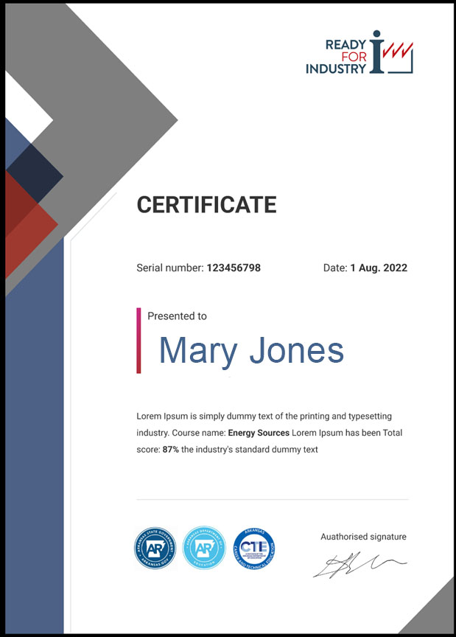
Certificate of Completion – Industry Credential(Coming Soon!)
Currently participants can earn a Certificate of Completion
Ready for Industry industry-recognized credential is being developed and planning for release later this year.

Slide 44
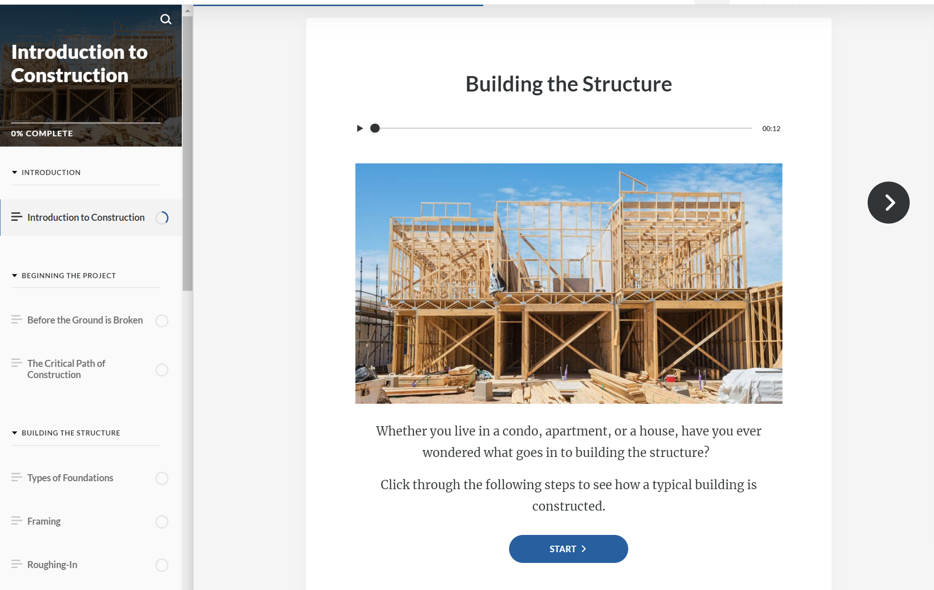
Ready for Industry –

Slide 45
Sign Up Today!
www.CareerBladeArkansas.com | www.ReadyforIndustry.com/AR
www.LearningBlade.com/AR
Learning Blade and Career Blade are registered trademarks of SAI Interactive, LLC.
Ready for Industry is a trademark of SAI Interactive, LLC.
Notes:
Mark

Slide 46
Request your FREE account today at
www.ReadyForIndustry.com/AR

Slide 47
For more information, please email:
Michele Linch, PhD
State Director, AR-CAPS
Michele@learningblade.com
Or Info@learningblade.com

