Slide 1
Perkins V - Strengthening CTE for the 21st Century Act
Full Implementation began during the 2020-21 school year
Increased stakeholder involvement
Must hold a Stakeholder Meeting and conduct a Local Needs Assessment every two years
Enhanced efforts to serve special populations
Increasing the employment opportunities for populations who are chronically unemployed or underemployed
Expanded to include homeless individuals and youth with active duty military parents
Encouraging innovation
Align with high-skill, high-wage, or in-demand occupations or industries
Allows support for CTE in the middle grades, 5 – 8
Requiring data-driven decision-making
Local needs assessment results
0% of the funds will be based on the number of children ages 5-17 who reside in each school district
Funds are not an entitlement and lose their identity within consortium
Funds are directed toward improvement of Perkins V Performance Indicators

Slide 2
Local Needs Assessment
Must include review of:
Student performance (Perkins Indicators)
Program quality (Size, Scope, and Quality)
Labor market needs (Align with high-skill, high-wage, or in-demand occupations)
Educator development (Recruitment, Retention and Training of CTE Personnel)
Special populations access to programs (Strategies for overcoming barriers for Special Populations)
Must be updated at least every two years
Perkins funding MUST be aligned to the local needs assessment

Slide 3
Student Performance
An evaluation of student performance based on established indicators:
Graduation rate – Four-Year and Five-Year Extended
Proficiency in Reading Language Arts, Math and Science
Post-Program Placement
Non-Traditional Program Concentration
Attainment of a recognized postsecondary credential

Slide 4
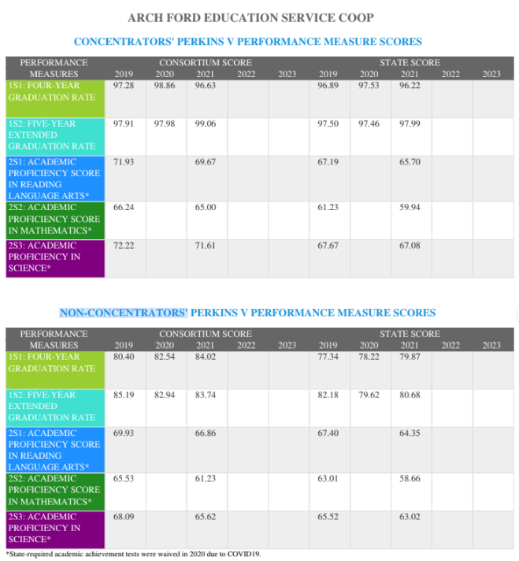

Slide 5
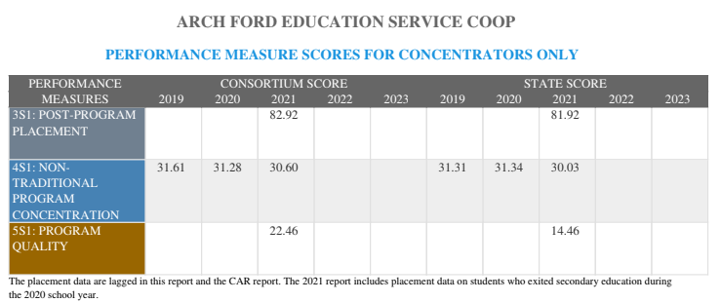

Slide 6
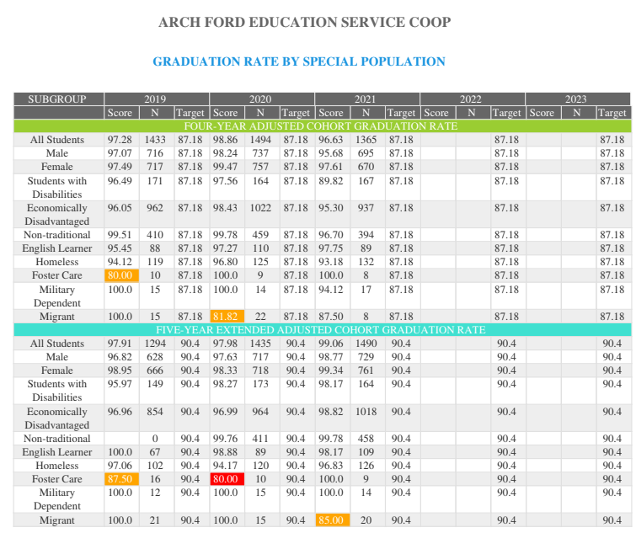

Slide 7
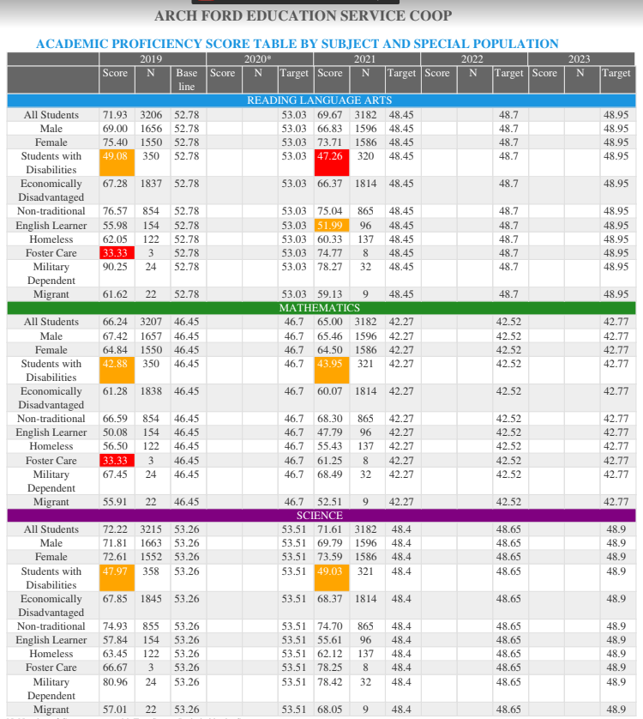

Slide 8
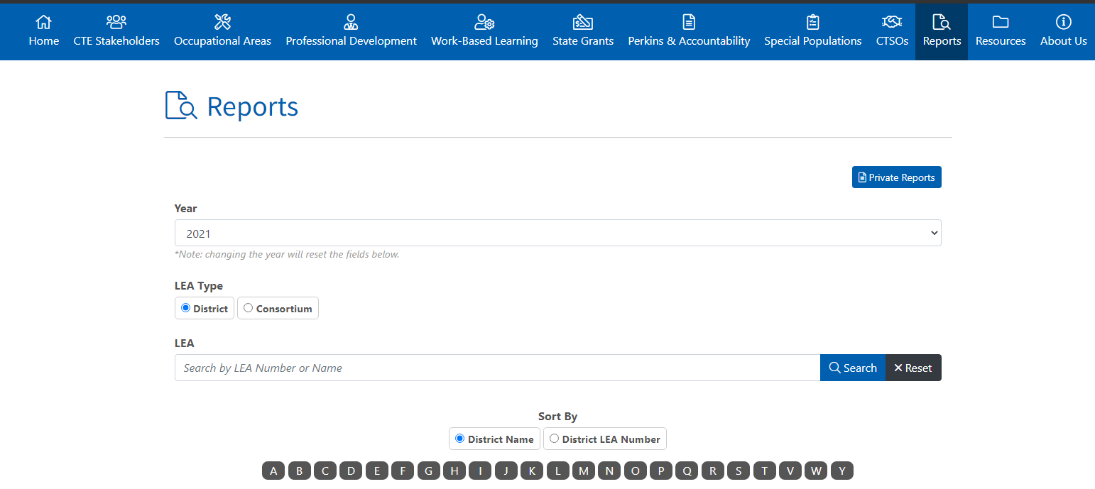
Perkins V

Slide 9
Perkins Funding
Any school which receives less than $15,000 must pool funds within a consortium
Funds are distributed by the following ratio:
- 70% of the funds will be based on the number of children in poverty ages 5-17 who reside in each school district
- 30% of the funds will be based on the number of children ages 5-17 who reside in each school district
Funds are not an entitlement and lose their identity within consortium
Funds are directed toward improvement of Perkins V Performance Indicators

Slide 10
Arch Ford Cooperative’s Perkins Consortium received $361,643 for the 2022-2023 school year for all 23 schools within the consortium.
Our smallest school district’s Perkins allocation is $5,458
Our largest school district’s Perkins allocation is $44,166
We have three schools within our Co-op region who choose to handle their own Perkins funds
Notes:
The amount of our Perkins allocations for all 23 school districts is less that the amount the Little Rock School District receives in Perkins funding.

Slide 11
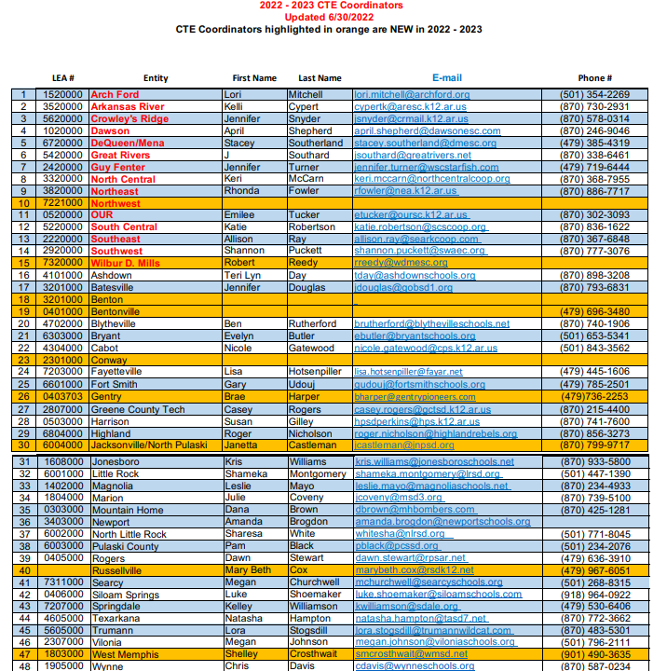

Slide 12
Perkins Projects
Must expand or improve your program or have a positive impact on the Perkins Performance Indicators
Each project must include a description, justification, benefit and cost estimate
Cannot purchase anything that is considered minimum equipment
Project must be of such size and scope to be replicated in other schools or programs
Must be approved through the Division of Career and Technical Education
Notes:
For example purchasing a single teacher laptop would not be approved. Purchasing a set of Healthy Appliances for all teachers teaching the Nutrition Science and Dietetics POS-Size and Scope
Teachers should submit any proposed Perkins project to your CTE Coordinator no later than May 15th for the following school year

Slide 13
Questions
Contact Information:
Lori Mitchell
501-354-2269
Lori.Mitchell@archford.org
Notes:
One thing I forgot to mention is your school’s CTE Department must have two Advisory Council Meeting per year. We take care of your Spring Advisory Council Meeting, but you all need to have a Fall Meeting.
Please talk to the other CTE teachers in your building to set a date.

