Slide 1

Defined Benefit Plan (401a)

Slide 2
Greeting and Introduction
Willie Kincade, Associate Director of Operations
Contact information
williek@artrs.gov
501-682-1517 ext. 1702

Slide 3
Topics of Discussion
  ATRS Board of Trustees
  General Overview of ATRS
  Agency Departments
  Retirement Information
  Actuarial Data
  Customer Service, www.artrs.gov, and info@artrs.gov
  Questions and Comments

Slide 4
Arkansas Teacher Retirement System
(ATRS is governed by a Board of Trustees)
11 – Elected Board Members
4 – Appointed Board Members (State Commissioner, State Treasurer, State Auditor, and Commissioner of Education)
76 Full-time Employees

Slide 5
Department Head
Administration – Clint Rhoden
Legal – Martha Miller
Data Processing – Millahalli Manjunath (Manju)
Investments – Donna Bumgardner
Fiscal– Curtis Curter/James Cookro
Internal Audit – Brenda West
Human Resources – Vicky Fowler
Membership – Sheila Hilton
Benefits and Counseling – Mark Twyford
Call Center – Tammy Irvin
Preretirement – Otis Willis
Accounting Reporting – Misty Yant
Accounting Payroll – Linda Hodge

Slide 6
Department (Cont.)
Scanning – Tammy Porter

Slide 7
Departmental Functions
Administration – (Senior Staff)
Legal – (ATRS General Counsel and Staff attorneys)
Data Processing – (System administration)
Investments – (ATRS portfolio)
Fiscal – (Budget, Buyer, and Logistics)
Internal Audit – (Risk Management)
Human Resources – (Personnel)
Membership – (Membership Records)
Benefits and Counseling – (In- House counseling)
Call Center – (Customer Service)
Preretirement – (Pre-recorded retirement videos, Customer Service , Zoom counseling and CHAT)

Slide 8
Departmental Functions (Cont.)
Accounting Reporting – (Employer Reporting and Receivables)
Accounting Payroll – (Benefits Payable)
Scanning – (Document processing)

Slide 9
Arkansas Teacher Retirement System
401(a) Defined Benefit Plan
Life-time Annuity
Cost of Living Raise (3%)

Slide 10
Contribution Rates
Effective July 1, 2022
7.00 % Employee Rate
15.00% Employer Rate (General Fund)

Slide 11
ATRS Retirement Webinars
General Information
A & S Entering T-DROP
A & S Retirement
A & S Exiting T-DROP
(www.artrs.gov), Preretirement Workshops

Slide 12
TYPES OF Purchase service*
Active Military
National Guard
Domestic Federal Service
Private School
Head Start
Overseas Service
Out of State
Graduate Assistant
Prior Service
Noncontributory to contributory
Repay Refund
Sabbatical Leave (after 1985)
* Certain conditions will apply to all or any purchased types.
* The cost to purchase any of these services is determined by using an actuarial cost method.

Slide 13

MILITARY CREDIT*
    FREE:
      Active members who began active duty before July 1, 1973
      Up to five years may be credited
    PURCHASED:
      Mandated service after July 1, 1973
      Up to five years may be purchased
    * Certain conditions will apply in order to establish service.

Slide 14
RECIPROCITY
The Arkansas reciprocal systems are:
  Arkansas Teacher Retirement System
  Arkansas Public Employees Retirement System
  Arkansas Highway Retirement System
  Arkansas State Police Retirement System
  Arkansas Judicial Retirement System
  Arkansas Local Police & Fire Retirement System
  And, for employees of certain institutions of higher learning, service while enrolled in an alternate retirement plan such as TIAA-CREF or VALIC is recognized.

Slide 15
  * If a member does not accrue service credit
  for the fiscal year (less than 40 days) the member may
  accumulate and carry forward days of contributory
  service until the first fiscal year in which the member
  accrues the minimum number of days required to
  credit 0.25 year of service credit.
Service credit
(FISCAL YEAR)
Number of Days worked in a Fiscal Year | Service Credit Earned
*0-39 days | none
40-79 days | 0.25 year
80-119 days | 0.50 year
120-159 days | 0.75 year
160 or more days | 1.00 year
Notes:
d

Slide 16
Benefit eligibility
Age 60 with 5 or more years of service (including reciprocal service)
Any age with 28 years of service (including reciprocal service)
Any age with 25 years of service (including reciprocal service)
  Reduction 10% per year for each year under 28 years of service; or number of years to age 60

Slide 17
OTHER BENEFITS
    5 Years Service Credit
      Disability Benefits (if active with 5 years of actual or reciprocal service credit with ATRS)
      Survivor Benefits (if active with 5 years of actual or reciprocal service credit with ATRS)
    10 Years Service Credit (Active and Retired)
      Death Benefit
        $10,000 All Contributory
        $6,667 All Noncontributory
        Mixed Contributory/Noncontributory – Prorated up to 10 years of contributory service, then it will be $10,000
      Stipend
        $50 per month ABOVE regular annuity

Slide 18
The T-DR0p plan
Retirement benefits are calculated when members enter T-DROP.
Members do not draw retirement benefits at this time.
Monthly deposits are put into member's T-DROP (savings) account based on a calculation that is cost neutral for the retirement system. The formula used for calculation is established by Arkansas law.
The amount of the monthly deposit is based on the regular monthly benefit reduced by 1% for each year of contributory, non-contributory, and reciprocal service; there is a further reduction if member has less than 30 years of service (6% for 29 years of service or 12% for 28 years of service).
Upon retirement members receive the T-DROP account plus monthly retirement benefits (which have been receiving the COLA each year the member has been in T-DROP).

Slide 19
IMPORTANT THINGS TO REMEMBER
BEFORE going back to work, contact ATRS.
  (i.e. retirement separation period.)
Sign up on website (www.artrs.gov)
Annual Statements
Retirement and T-Drop Deadlines
Contact ATRS for major life events
How to reach ATRS:
    (501) 682-1517 local
    (501) 682-2359 fax
    Email us at: info@artrs.gov
Notes:
19
If you plan to return to work, be sure to contact
ATRS prior to doing so.
Sign up on the website
Make sure your beneficiary selection is
Up-to-date
Notify ATRS of life changes
Contact ATRS

Slide 20
Actuarial ASSUMPTION RATE
Assumed Rate of Return 7.25%
RP 2014 (Mortality Table)
Plan Value $21 Billion
Amortization Period at 32 years
81% Funded

Slide 21
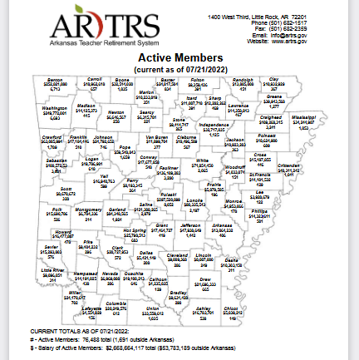
System (Active)
$2.6 B (Salaries)
76,488 Members

Slide 22
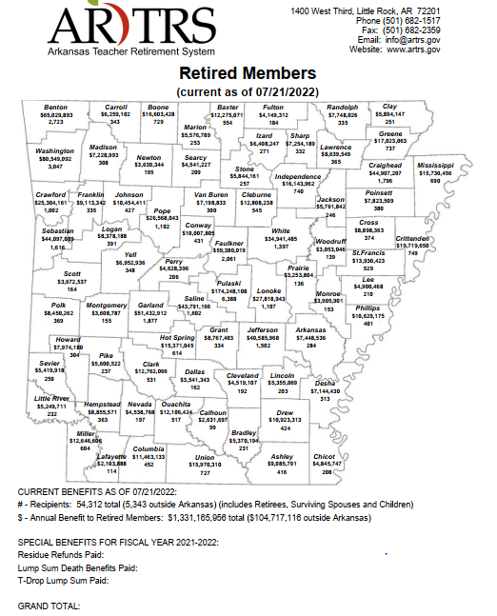
System (Retirees)
$1.3 B (Benefits)
54,312 Members

Slide 23
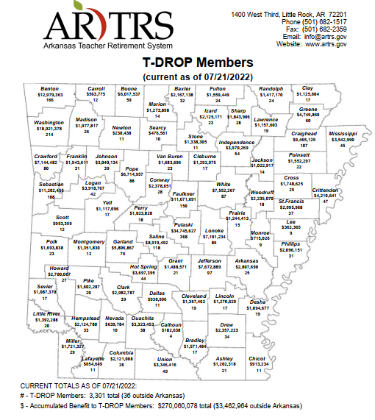
System (T-DROP)
$270 M (Benefits)
3,301 Members

Slide 24
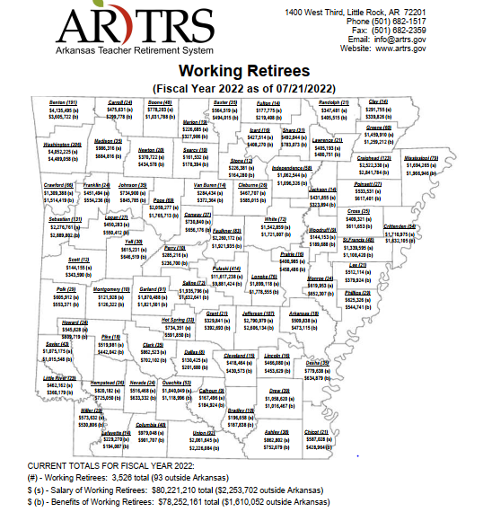
System (Working)
$78.2 M (Benefits)
3,526 Members
$80.2 M (Salaries)

Slide 25
ATRS Website - www.artrs.gov
24-Hour Access to Your Member Data...
Member Access - allows members and retirees to access their membership data at any time. (Benefits Paid, Tax and Insurance Deductibles, Beneficiaries, T-DROP history, Cash Balance Account, and 1099 Tax info)
Secure - to access membership data, members and retirees must complete the website registration process and have their information successfully validated by ATRS.
For Troubles Signing Up – just call ATRS and we will walk you through the process. (501-682-1517) Call Center Staff
Notes:
25
24 Hour access
View Member Data (benefit payments history,
list of beneficiaries, T-DROP history, CBA, and
1099)
Secure Sign up process

Slide 26
Questions and Comments

